Slide 1
MULESOFT QUIZ QUESTIONS

Slide 2
Quiz Rules
The quizzes consists of questions carefully designed to help you self-assess your comprehension of the information presented on the topics covered in the module.
Each question in the quiz is of multiple-choice format
The quiz will consist of 3 questions.
Each question will generally have four options, and participants must choose the correct answer.
You can only submit your answers once.
Participants will earn points for each correct answer, and the winner will be chosen at the final session.
The top 3 participants will be chosen based on the number of right questions answered, and then we will randomly choose one lucky winner from the top 3.
We will be maintaining all the participants ranks with us.
For each question, there will be only one participant who gives the fastest right answer, and they are not allowed to give multiple answers to the same question.

Slide 3
Day 4

Slide 4
1. What is the minimum required configuration in a flow for a Mule application to compile?
An event processor
An event source
A logger component
A project RAML file
Answer: A

Slide 5
22. What is the purpose of api:router element in APIkit? 2. What is the purpose of api:router element in APIkit?
Serves as an API implementation.
Validates responses returned from API requests and routes them back to the caller.
Creates native connectors using a 3rd party Java library.
Validates requests against RAML API specifications and routes them to API implementations.
Answer: D

Slide 6
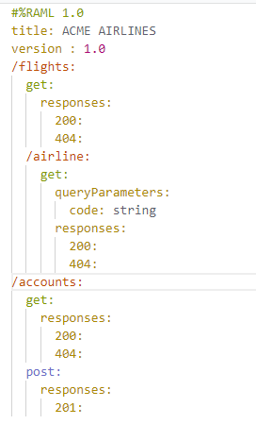
3. Refer the exhibit. How many private flows does APIKit generate from the RAML specifications?
1
2
3
4
Answer: D

